Slide 1
CS 3300: Mid-term project presentation Software development Plan (SDP) briefing
Project title: Missile Money
Date: 07OCT2025
DEPARTMENT OF COMPUTER SCIENCE
UNIVERSITY OF COLORADO at COLORADO SPRINGS
Chart Briefer’s Name

Slide 2
team
Tester:
Front end developer:
Platform Engineer:
Scrum Master:
Back-end developer:
Chart Briefer’s Name

Slide 3
Project introduction
Project title: Missile Money
Money management website that will provide an intuitive interface for end users that can help the user mange their money, cancel unwanted subscriptions, and save or invest money more effectively
Chart Briefer’s Name

Slide 4
Problem statement
Managing personal finances is mor complex than it has ever been while apps like rocket money assist with tracking subscriptions and budgeting, these apps often fall short for delivering key capabilities that the end users can leverage to more effectively manage finances
Chart Briefer’s Name

Slide 5
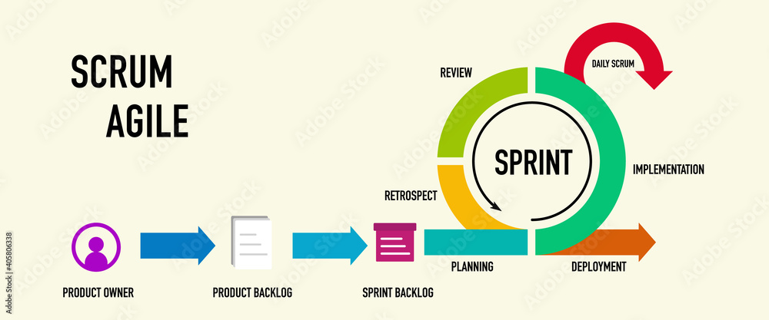
Software engineering principles
Agile development, we are using this methodology so we can break the work into two-week sprints to simplify and expedite the rate at which we deliver capabilities
We will be using the scrum method within Agile
Chart Briefer’s Name

Slide 6
Software engineering Tools
Python for core development of the web framework
Django library within python for the build in functionality and ease of use for developing websites
PostgreSQL for database because it is the preferred database to use with Django
GitHub for collaboration, version control, and GitHub actions for automated testing
PyTest / Djangos built in test framework
AWS CloudWatch for cluster and app monitoring
GitHub projects for task tracking
Chart Briefer’s Name

Slide 7
Project architecture diagram
Include your planned project architecture diagram
Architecture is the critical link between requirements and programming engineering, as it identifies the main structural components in a product and the relationships between them
Architecture is concerned with the architecture of the individual program, the way that it is decomposed into components (Lecture 7) EXECUTABLE PROGRAM
Logical - depicting key abstractions in the system as objects or object classes
Process - shows how, at run-time, the system is composed of interacting processes
Development – reflecting how the software is decomposed for development
Physical - showing the system hardware and how software components are distributed across the processors in the system
Related - depicting use cases or scenarios (+1)
Chart Briefer’s Name

Slide 8
Project Software design diagram
Include your planned project CODE design diagram
Models are a good way of facilitating discussions about a SOFTWARE design (LECTURE 8)
For most complex systems, implementation is not the major problem – requirements engineering, security and dependability, integration with legacy systems and testing are all more significant
Software design is a creative activity in which you identify HOW the software components and their relationships, based on a customer’s requirements (LECTURE 8) will be organized – state diagrams, sequence diagrams, interface diagrams, etc.
Chart Briefer’s Name

Slide 9
Project Perspective model diagram
Include at least one perspective model diagram
Perspective
External/Context, modeling the context or environment
Interaction, modeling component and/or environment interactions
Structural, modeling organization or data structure
Behavioral, modeling behavior, responses to events
Chart Briefer’s Name

Slide 10
Project requirements
Present the planned project decomposed requirements spreadsheet to include deliveries and testing information
Chart Briefer’s Name

Slide 11
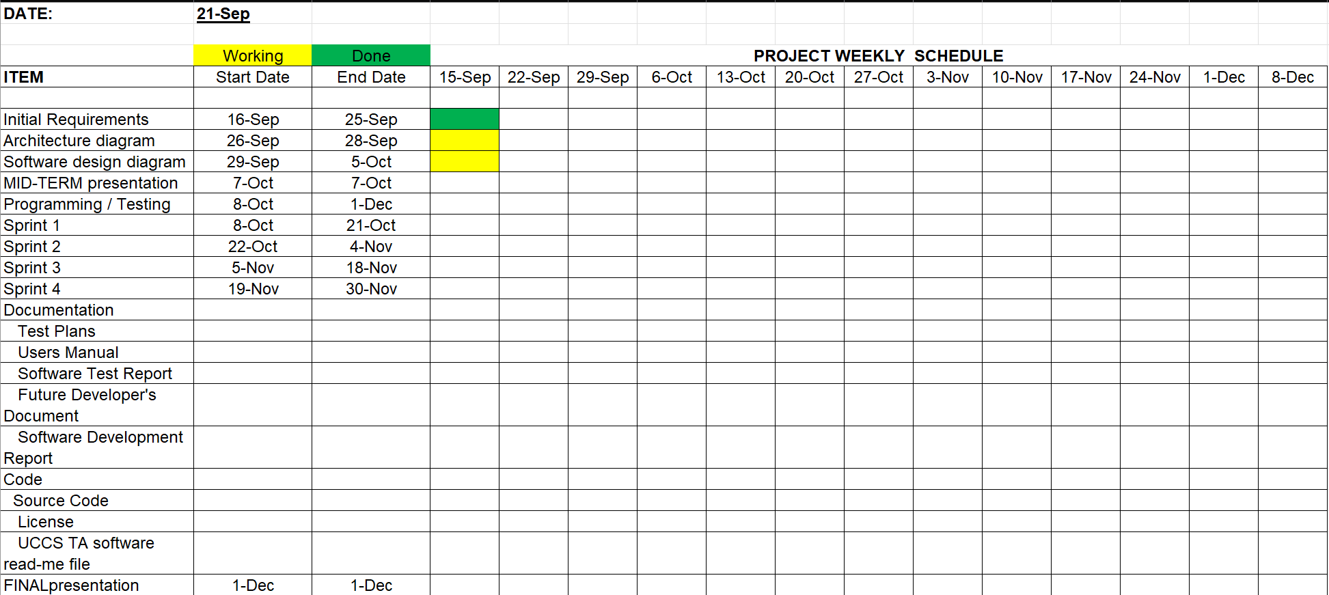
Project schedule
Chart Briefer’s Name

Slide 12
Project software development
Most code will be written in python, HTML for the frontend
All the code will be interpreted in CPython 3.12 or newer
Leveraging Django as an open-source web framework
Leveraging AWS as the underlying infrastructure to host the web application
Chart Briefer’s Name

Slide 13
Project configuration management
Leverage GitHub for version control and CI/CD capabilities through GitHub actions
Utilize containers within Kubernetes for environment consistency
Dependencies for the project will be outlined in requirements files
Enforce change control through pull requests withing Github
New functionality added to the project will be created in feature branches and then merged into the main branch
Chart Briefer’s Name

Slide 14
Project verification
Small unit tests with Django’s built-in test framework
Testing in the integrated environment to ensure the system as a whole works
Selenium for automated testing to ensure the browser works as expected
Manual testing by end user / test team
Chart Briefer’s Name

Slide 15
Ethics
User data privacy
Implementing best security practices for storing sensitive data
Ensure good financial advice is presented on the platform
Chart Briefer’s Name

Slide 16
RISK MANAGEMENT
Someone on the team is sick and cannot make their sprint deadline
Will handle this by flexing someone else on the team to make up their work
Data privacy and security risks
Will use strong encryption algorithms and secure authentication
Technical and operational risks, downtime
Will implement failover in the platform engineering and horizontal autoscaling in order to compete with potential demand
Chart Briefer’s Name

Slide 17
Project completion
The final product will be a website with an intuitive interface that makes up for some pitfalls of other money management applications on the market today
QUESTIONS?
Chart Briefer’s Name

